Slide 1
IOT Security Gateway
Intrusion Detection In IOT Nets
Sakshi Kulkarni
Vishal Sivakumar
Supervisor - Prof. Dr.-Ing. Axel Sikora

Slide 2

How detection is done?
Methods and Models
Results
References

Slide 3
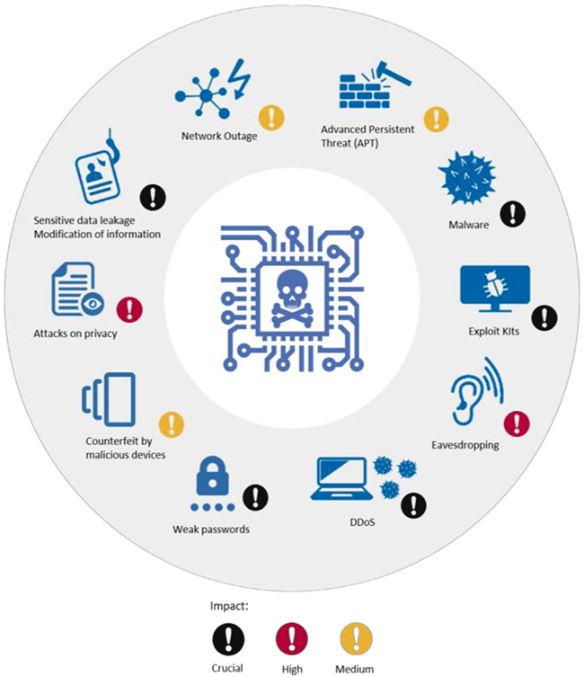
How detection is done?
.
.
.
.
.
.
.
.
.
.
.
AI
Heuristic Analysis
Signature-Based Detection
[1]

Slide 4
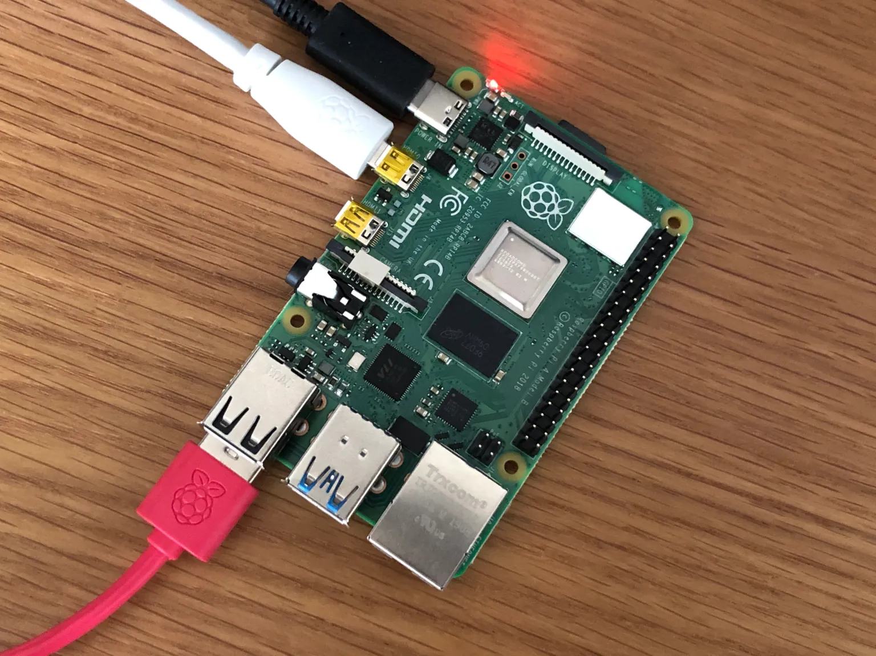
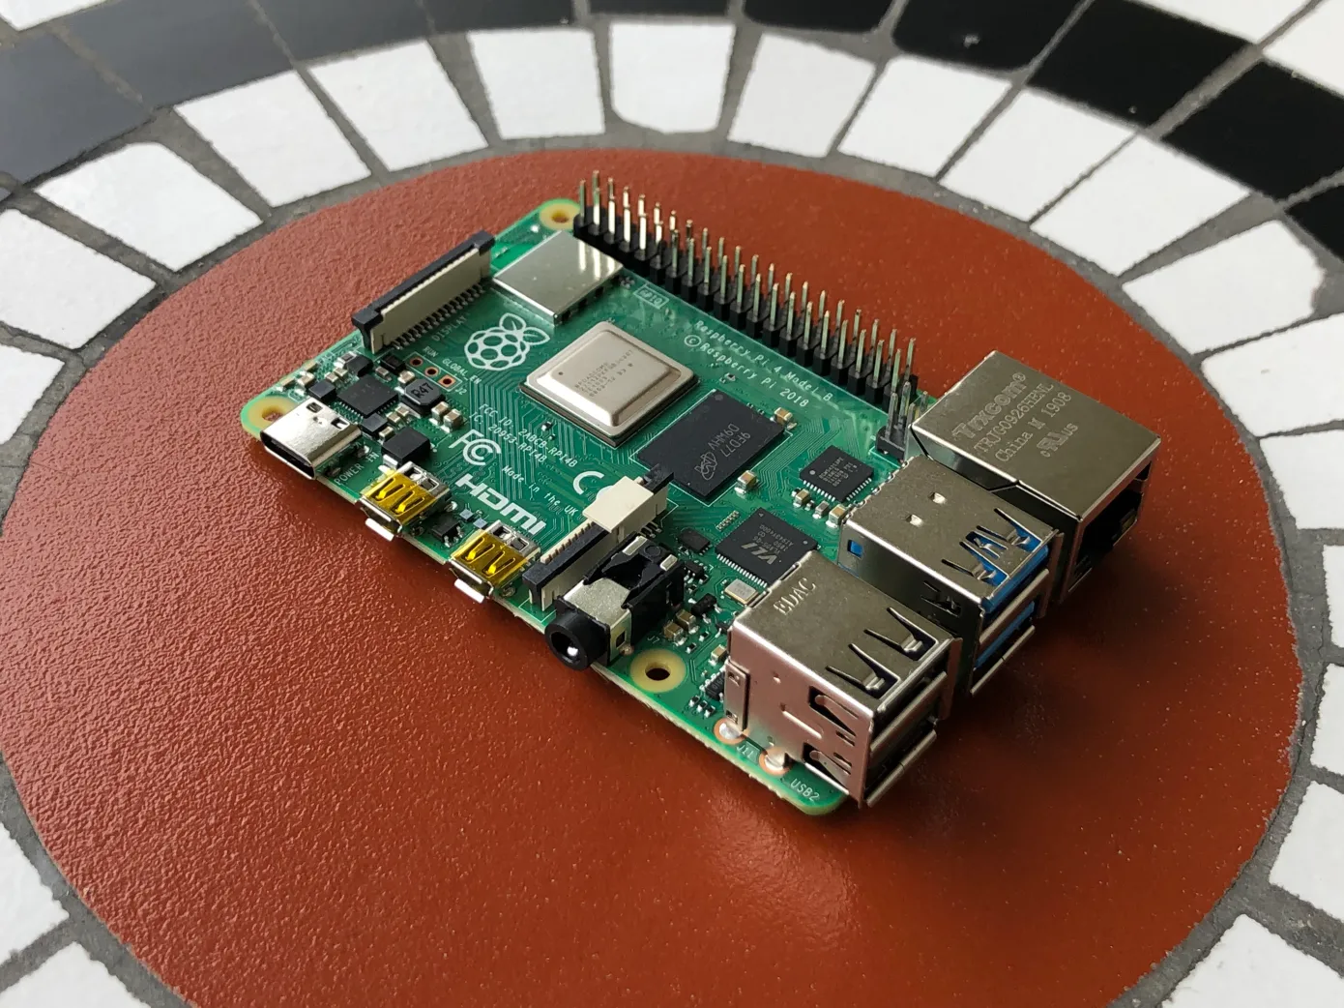
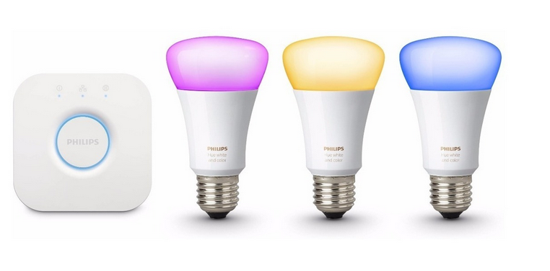
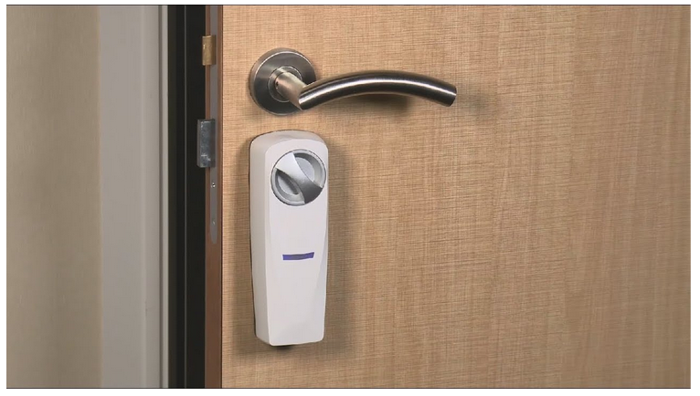
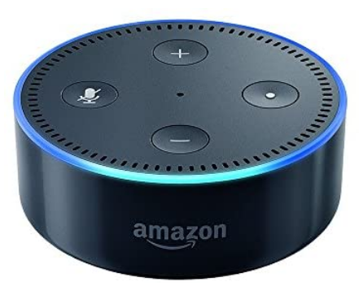
Real and Infected IOT Devices
[4]
3 Real IOT Devices :
Philips HUE smart LED lamp
Amazon Echo home intelligent personal assistant
Somfy smart doorlock
[6]
[6]
[4]
[4]
[4]

Slide 5
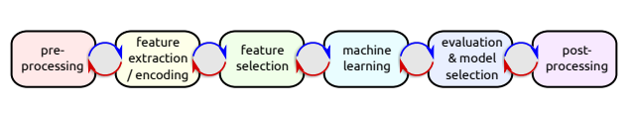
ML design cycle
Prof. Dr. Josif Grabocka

Slide 6


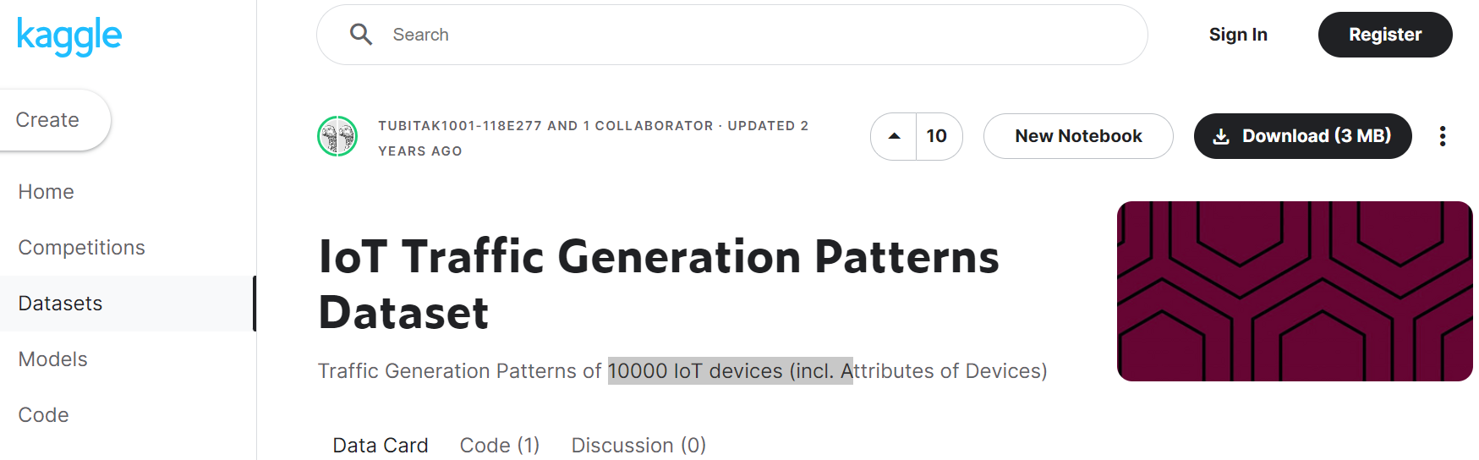
Dataset Selection
[2]
[4]
[3]

Slide 7
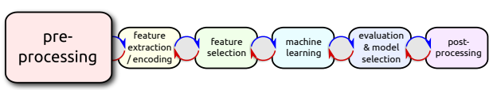
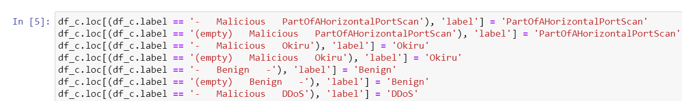
Pre-processing
Prof. Dr. Josif Grabocka

Slide 8
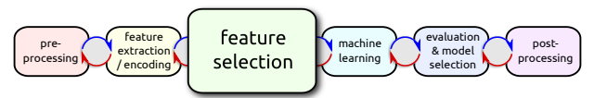
Feature selection
Prof. Dr. Josif Grabocka

Slide 9
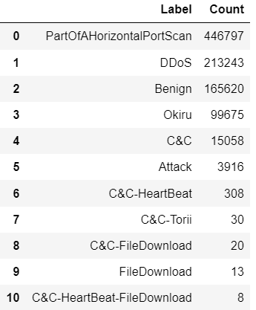
Label overview

Slide 10
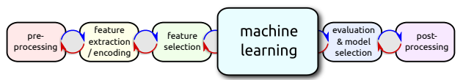
Models
Naive-Bayes
-Random Forest
-AdaBoost
MLP
SVM
Prof. Dr. Josif Grabocka

Slide 11
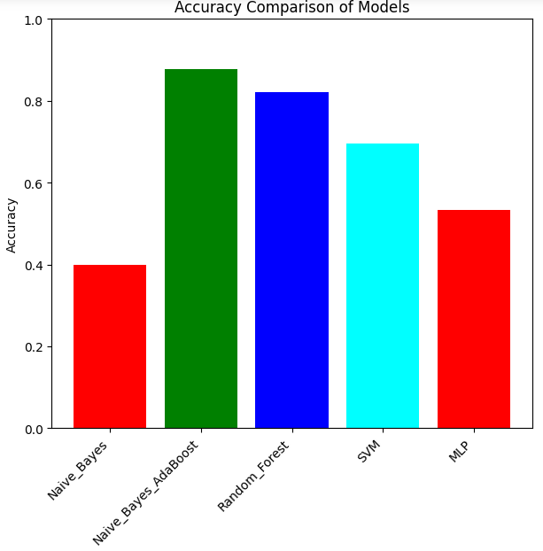
Accuracy and confusion matrix

Slide 12
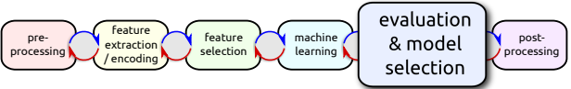
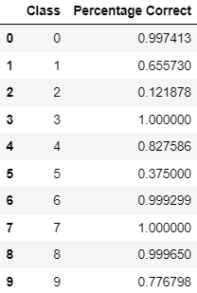
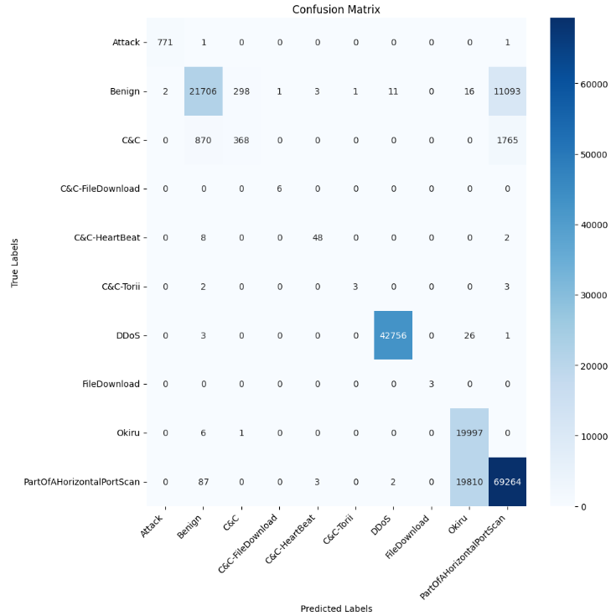
Random-Forest
Prof. Dr. Josif Grabocka

Slide 13
References
HD Wallpaper: Codes On A Screen, artificial intelligence, developing, web design | Wallpaper Flare. (n.d.). Retrieved from https://www.wallpaperflare.com/codes-on-a-screen-artificial-intelligence-developing-web-design-wallpaper-aiwog
IDS 2018 | Datasets | Research | Canadian Institute for Cybersecurity | UNB. (n.d.). Retrieved from https://www.unb.ca/cic/datasets/ids-2018.html
IoT Traffic Generation Patterns Dataset. (2021, November 11). Kaggle. Retrieved from https://www.kaggle.com/datasets/tubitak1001118e277/iot-traffic-generation-patterns
IoT-23 Dataset: A labeled dataset of Malware and Benign IoT Traffic. — Stratosphere IPS. (n.d.). Stratosphere IPS. Retrieved from https://www.stratosphereips.org/datasets-iot23
Security, H. N. (2017, November 21). Defining and securing the Internet of Things - Help Net Security. Help Net Security. Retrieved from https://www.helpnetsecurity.com/2017/11/22/defining-securing-iot/
TechCrunch is part of the Yahoo family of brands. (2019, June 23). Retrieved from https://techcrunch.com/2019/06/23/the-raspberry-pi-foundation-unveils-the-raspberry-pi-4/?guccounter=1&guce_referrer=aHR0cHM6Ly93d3cuZ29vZ2xlLmNvbS8&guce_referrer_sig=AQAAAAgi8O8ROYuFBWx1jrJmfR91osTMSci87c-sA-1IU3uTHOYZuEHcwfmRoQUbY1CMkUsHRWHvEhFFmcFhn0LWmdACkBQ1bVLVTkPKvt9lAmI_6QRGNDOfsRRcLJCNR38juUvypqoxL1CmGCkga9Q2BpZwasZwgDxhqu5oFK4DYUEm

Slide 14
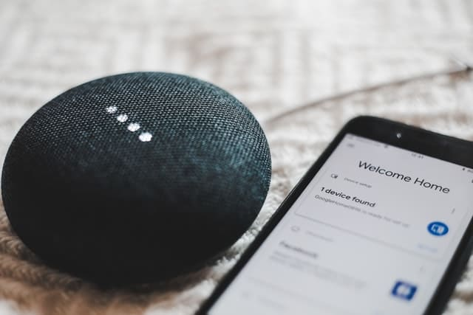
Questions
Thank YOU

